Slide 1


Autobot
Autobot always by your side

Slide 2
CONTENTS
About Us
Introduction
User Function
Interaction

Slide 3
Part One
About Us
T05 Instructor:Dr.Abram Hindle
Ta:Dong,Wang
Jiaxi Lyu
Wenzhuo Zhang
Weida Wang
Xuechun Qiu
YiPing Yang
Zonglun Li

Slide 4
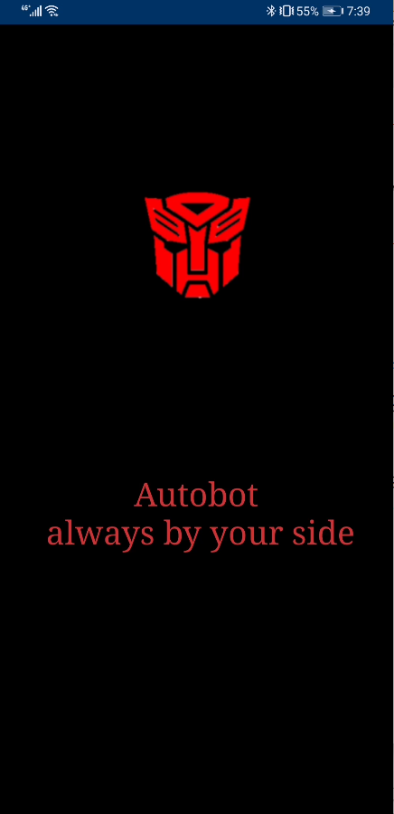

Part TWO
Introduction
Autobot is the project for CMPUT301.
The objective is to design and implement a simple, attractive, and easy-to-use Android application.
The end result will be a mobile application which provides a convenient stage for Rider and Driver to pull a trip request, accept request and pay online.

Slide 5
Part Three
User Function

Slide 6
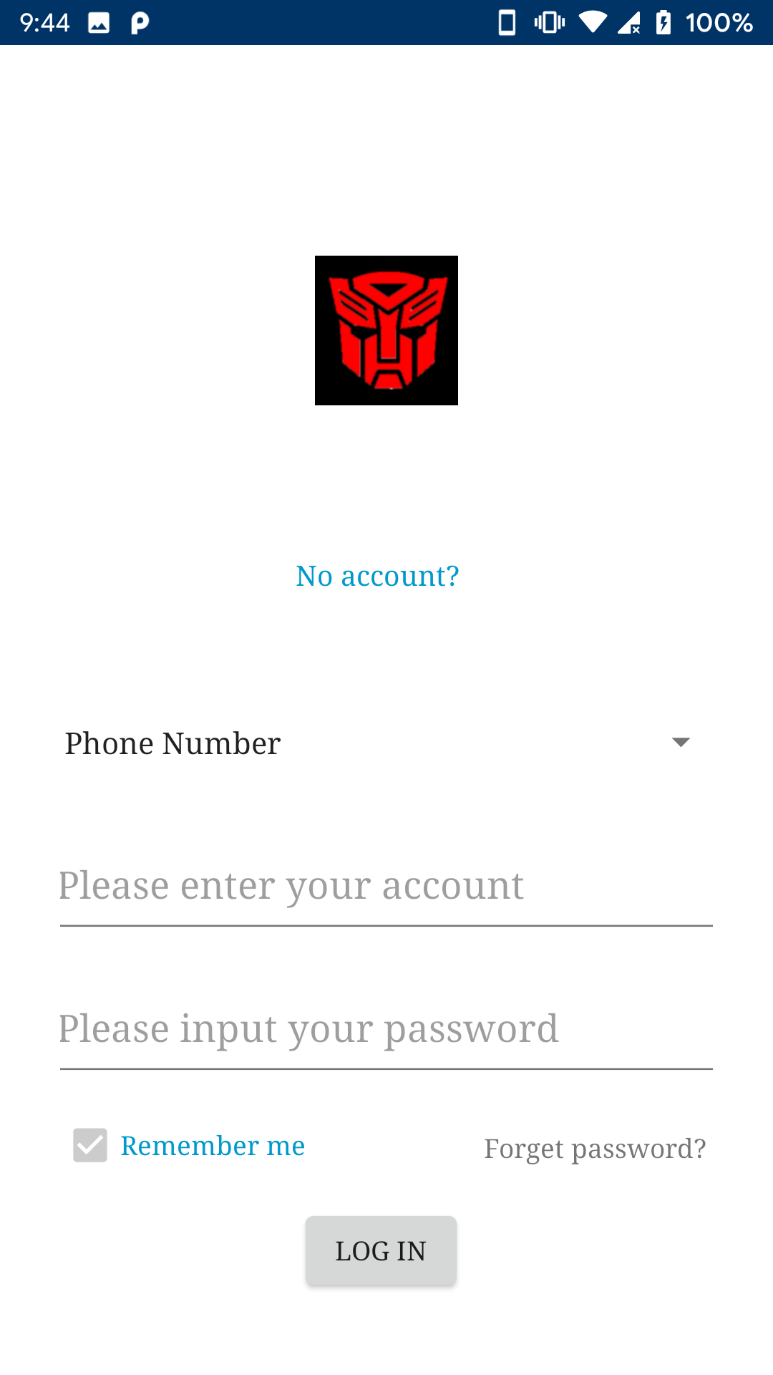
Log in.
Sign up
Log in by phone number or user name
Remember me
Log in

Slide 7
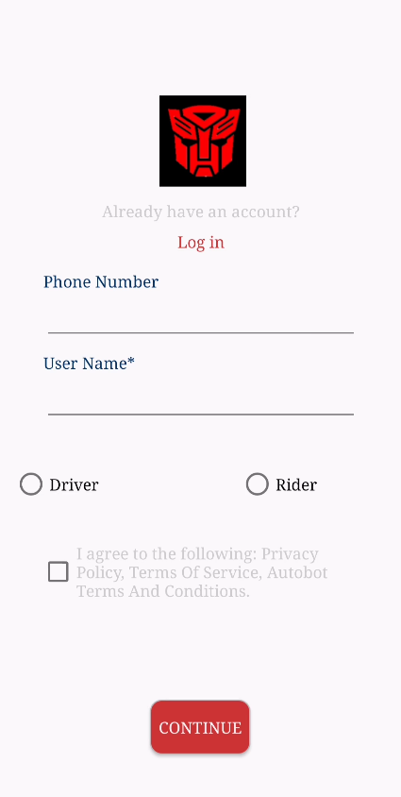
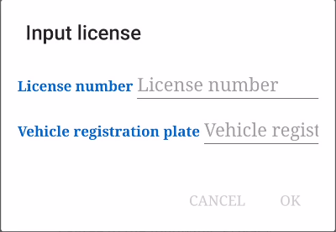
Sign up
Log in
Unique Phone and user name
User type
turn to set Password

Slide 8
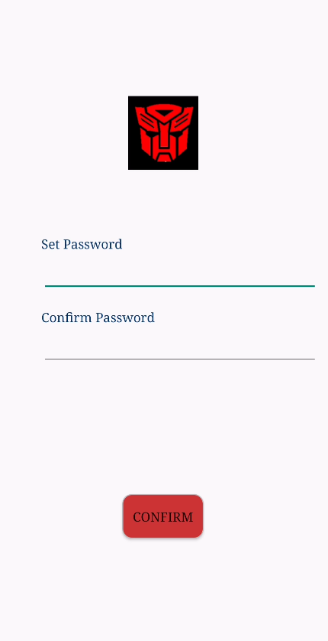
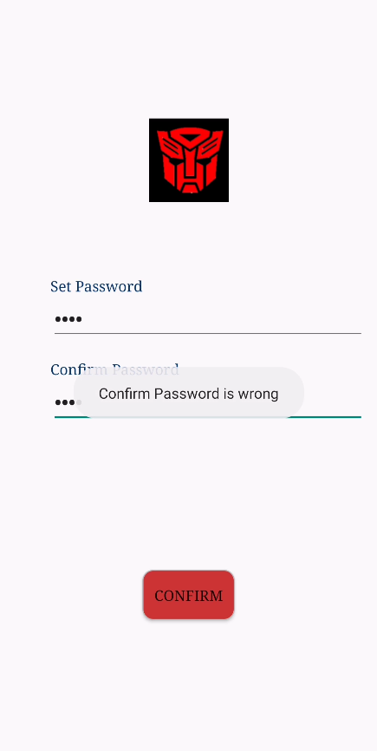
Set Password
Check password
Log in

Slide 9
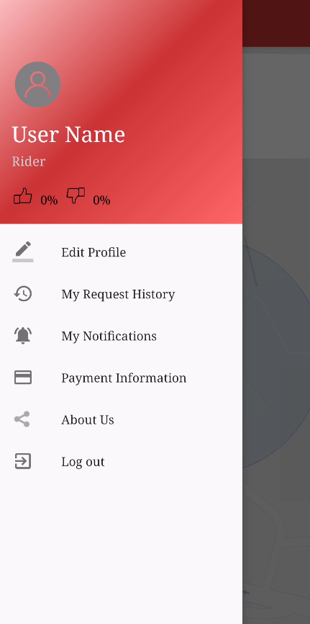
Menu
Photo
Name
User Name
Rate
Edit Profile
My Request History
My Notifications
Payment Information

Slide 10
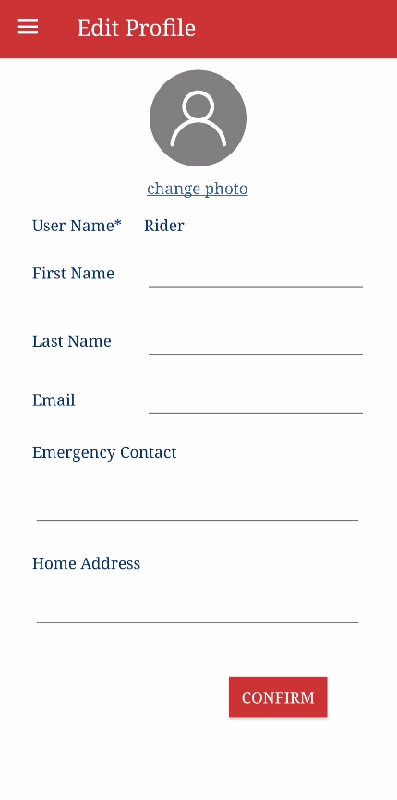
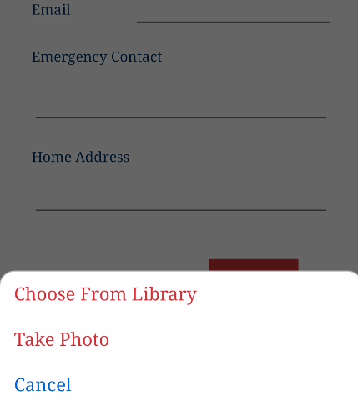
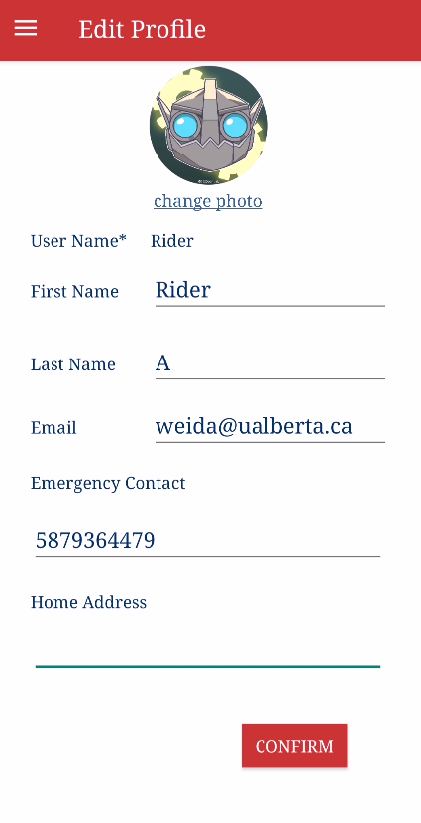
Edit Profile
set information
change photo

Slide 11
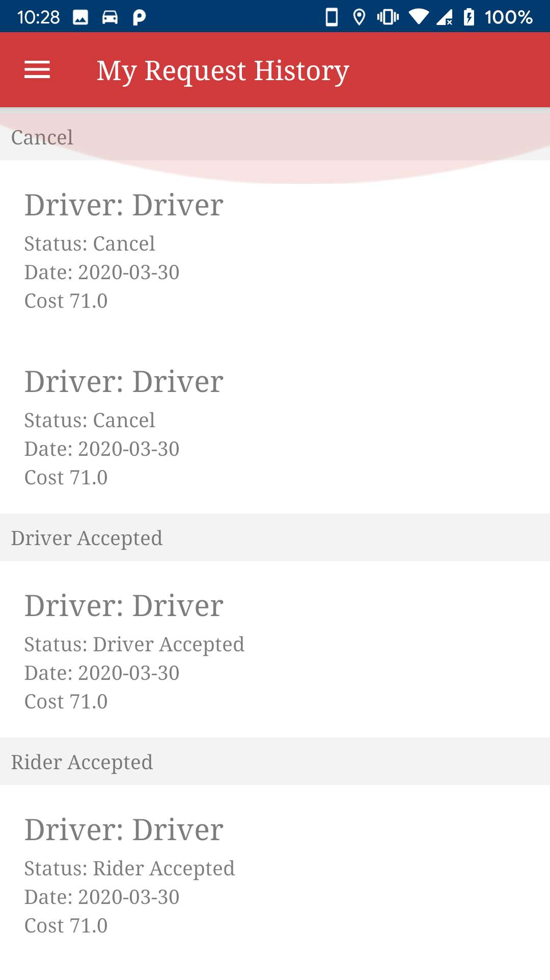
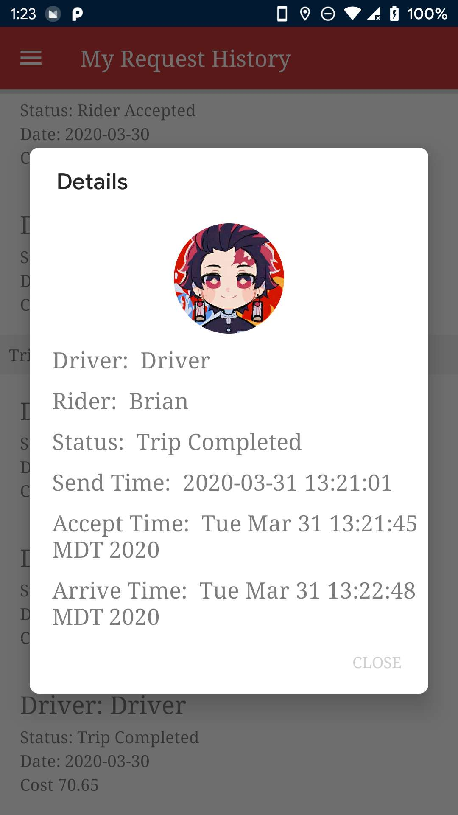
Request History
Click

Slide 12
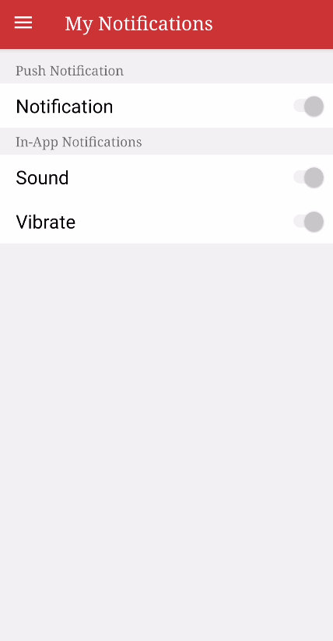
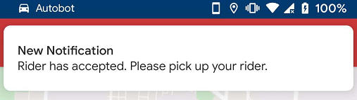
My Notifications

Slide 13
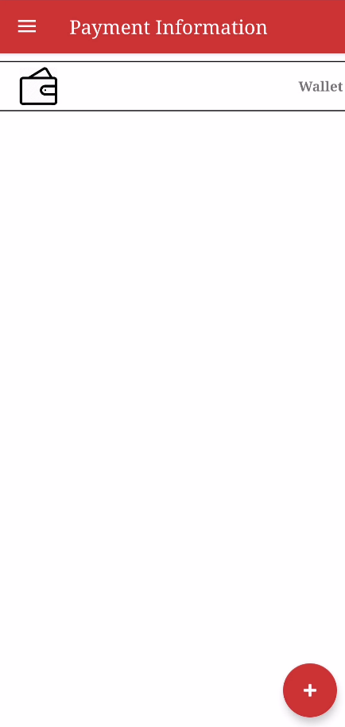
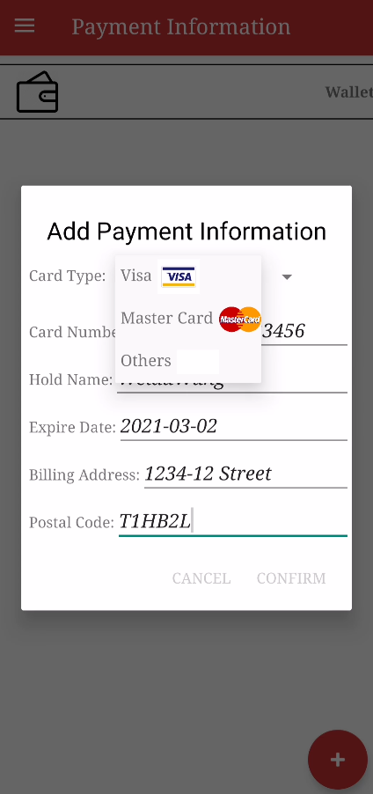
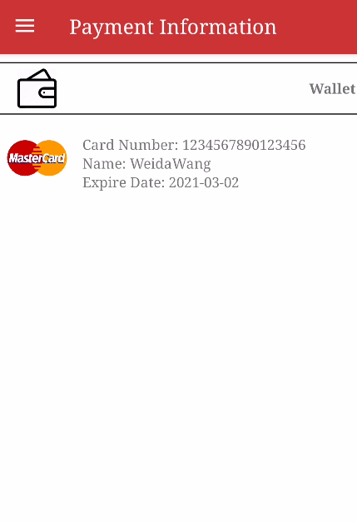
Payment Information
Wallet
Add

Slide 14
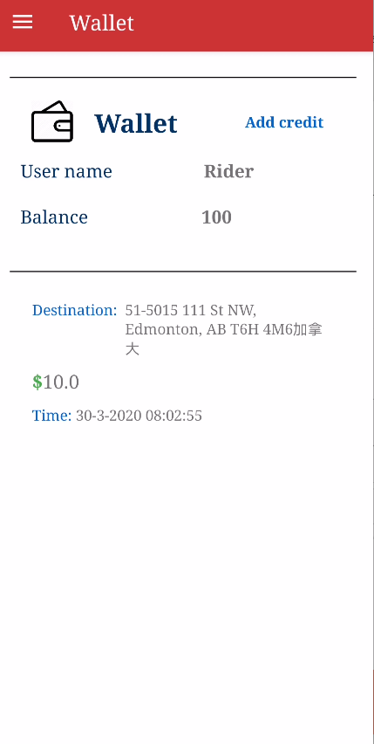
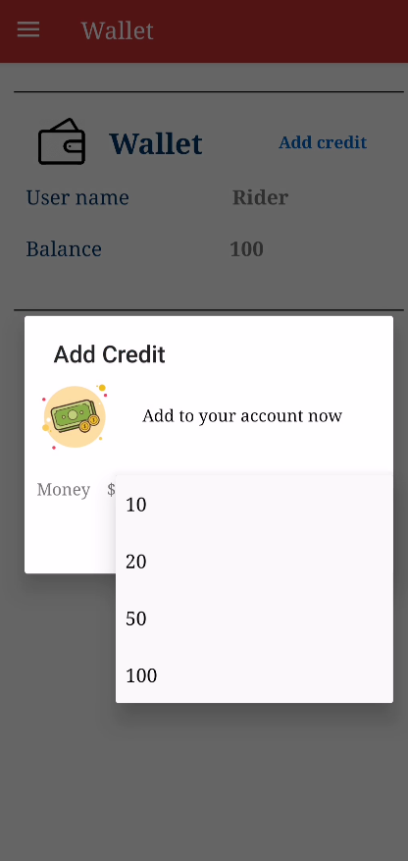
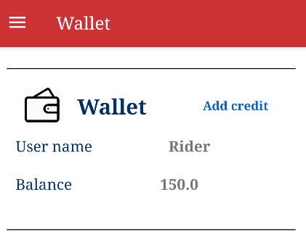
Wallet
Add
New balance
history

Slide 15
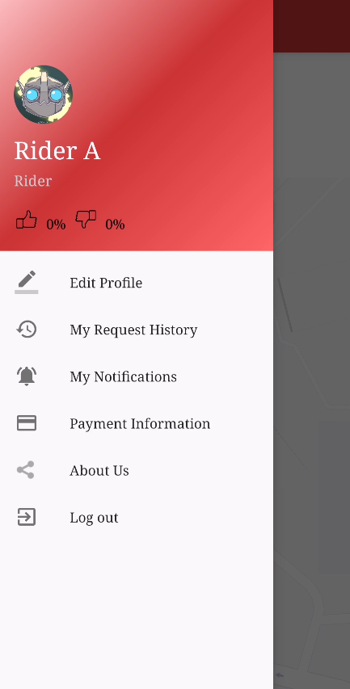
Menu
Photo
Name
User Name
Rate
Edit Profile
My Request History
My Notifications
Payment Information

Slide 16
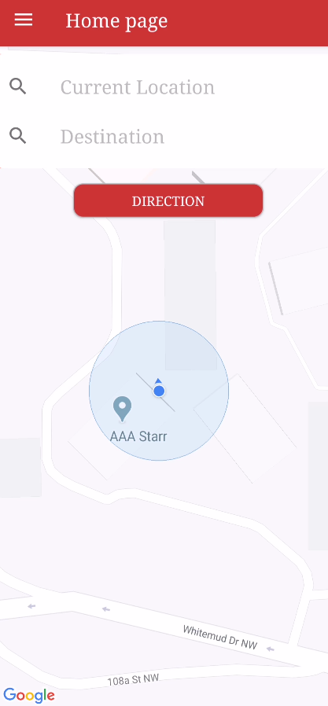
HomePage
Rider

Slide 17
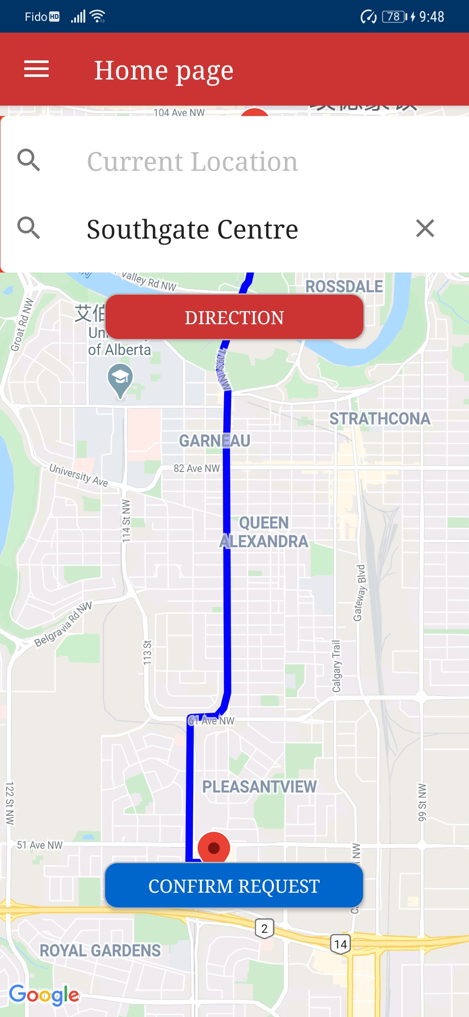
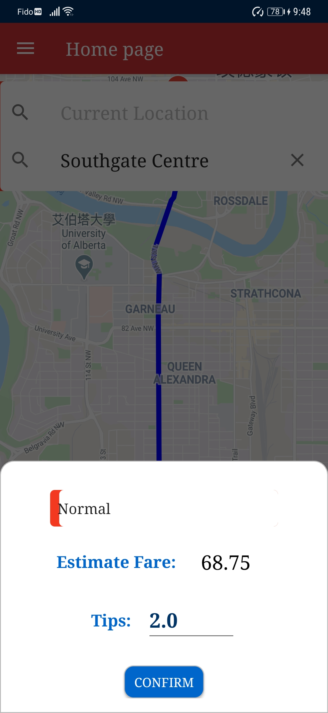
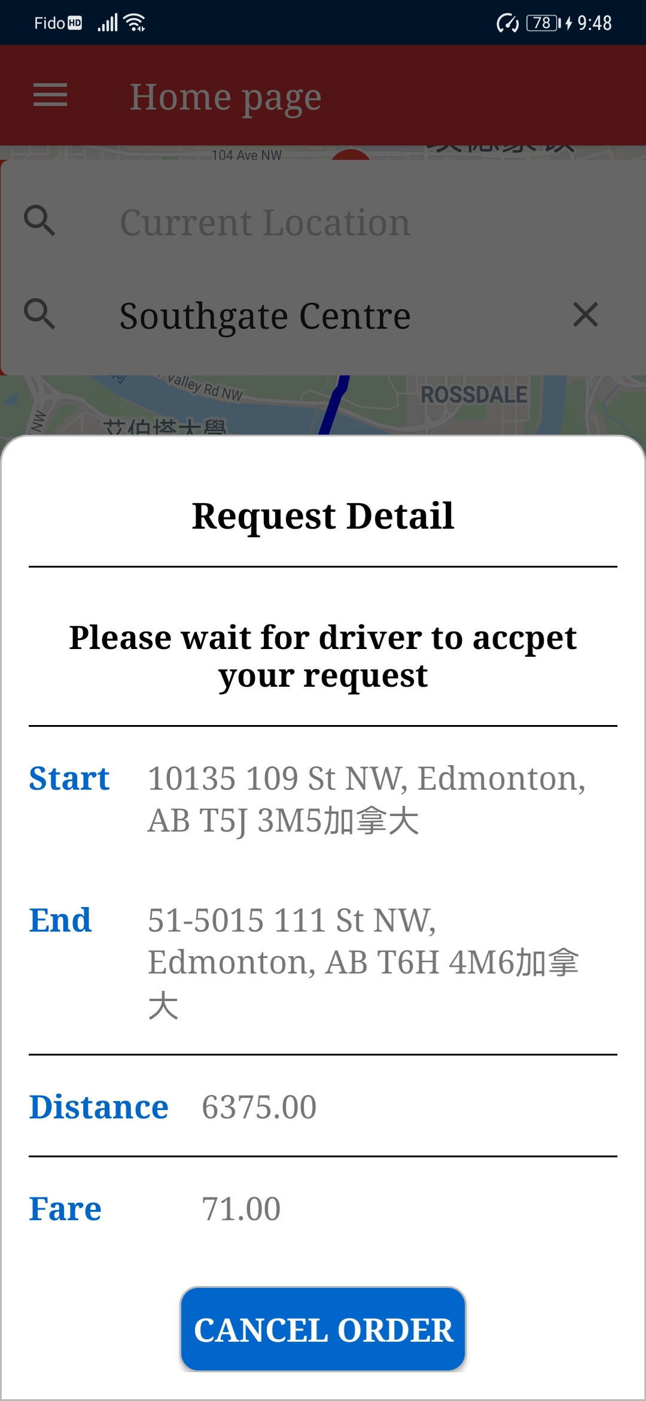
Send Request
Confirm
Confirm

Slide 18
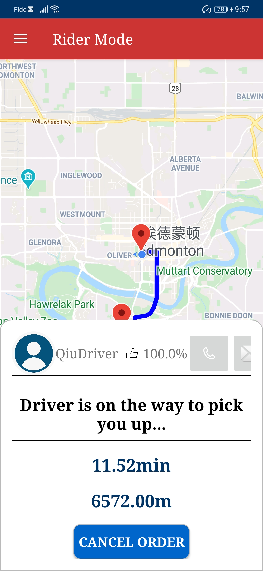
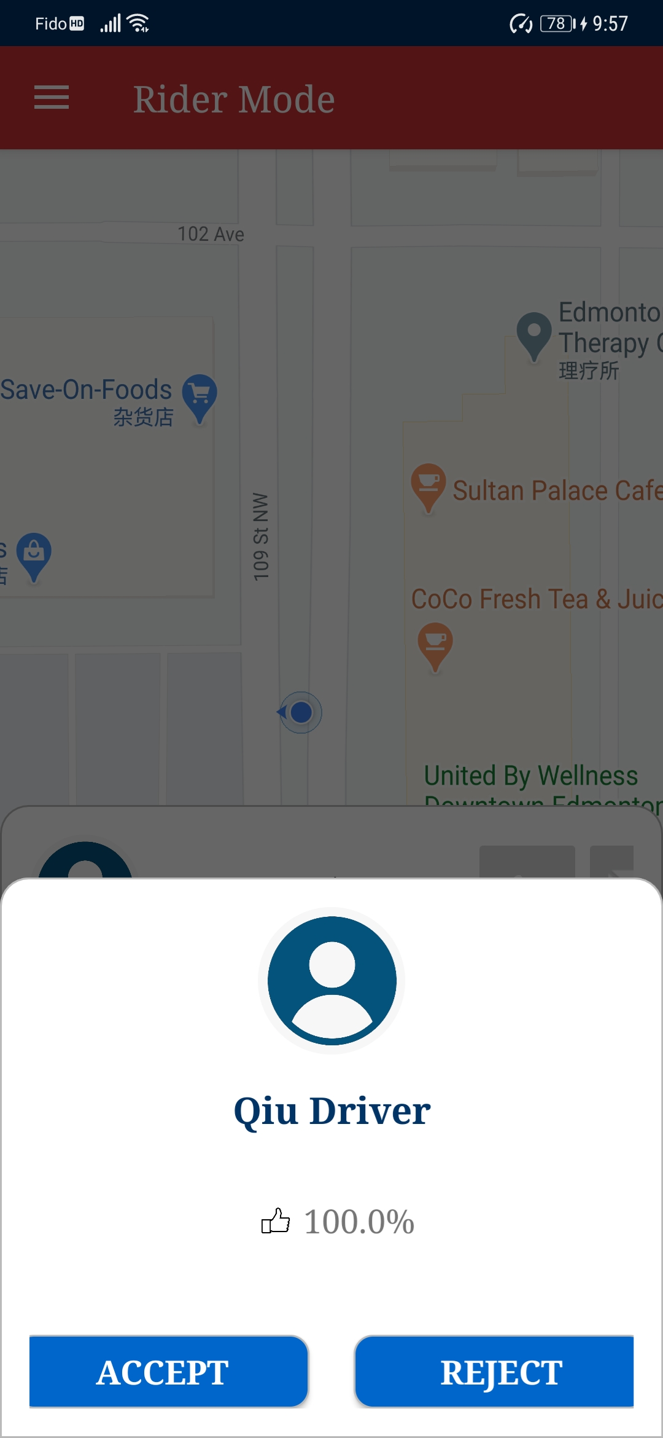
Rider Accept or Reject Driver
Accept
Reject

Slide 19
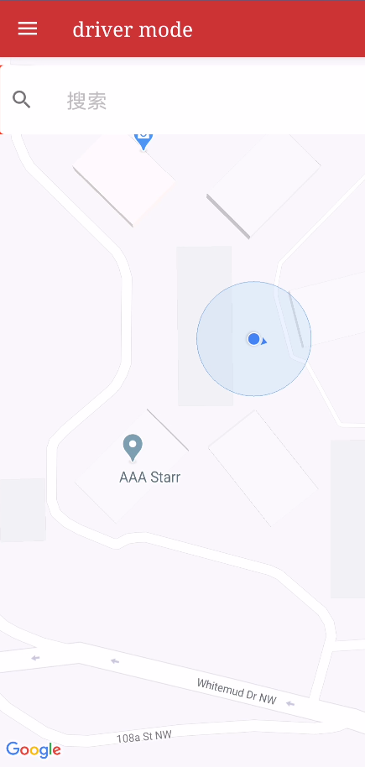
HomePage
Driver

Slide 20
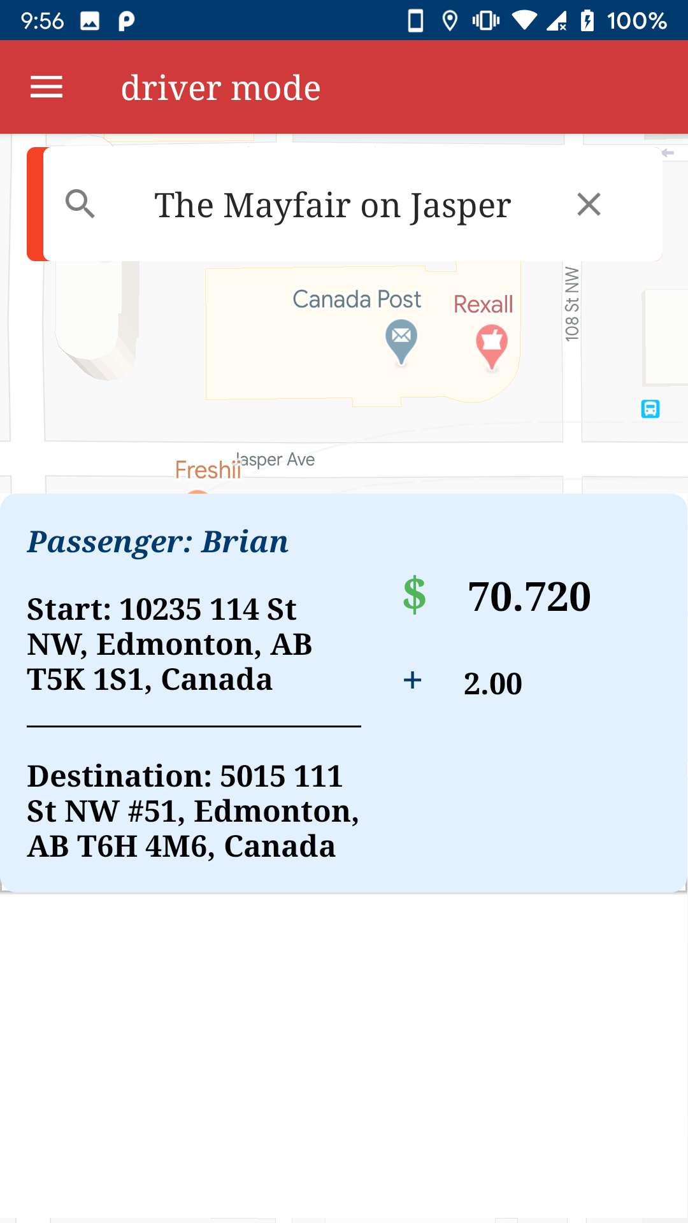
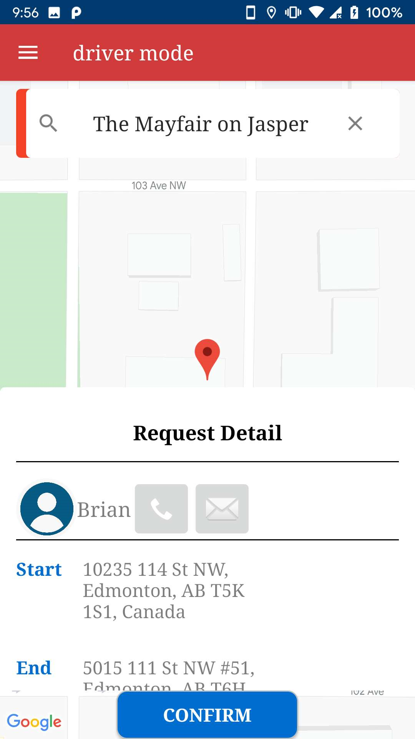
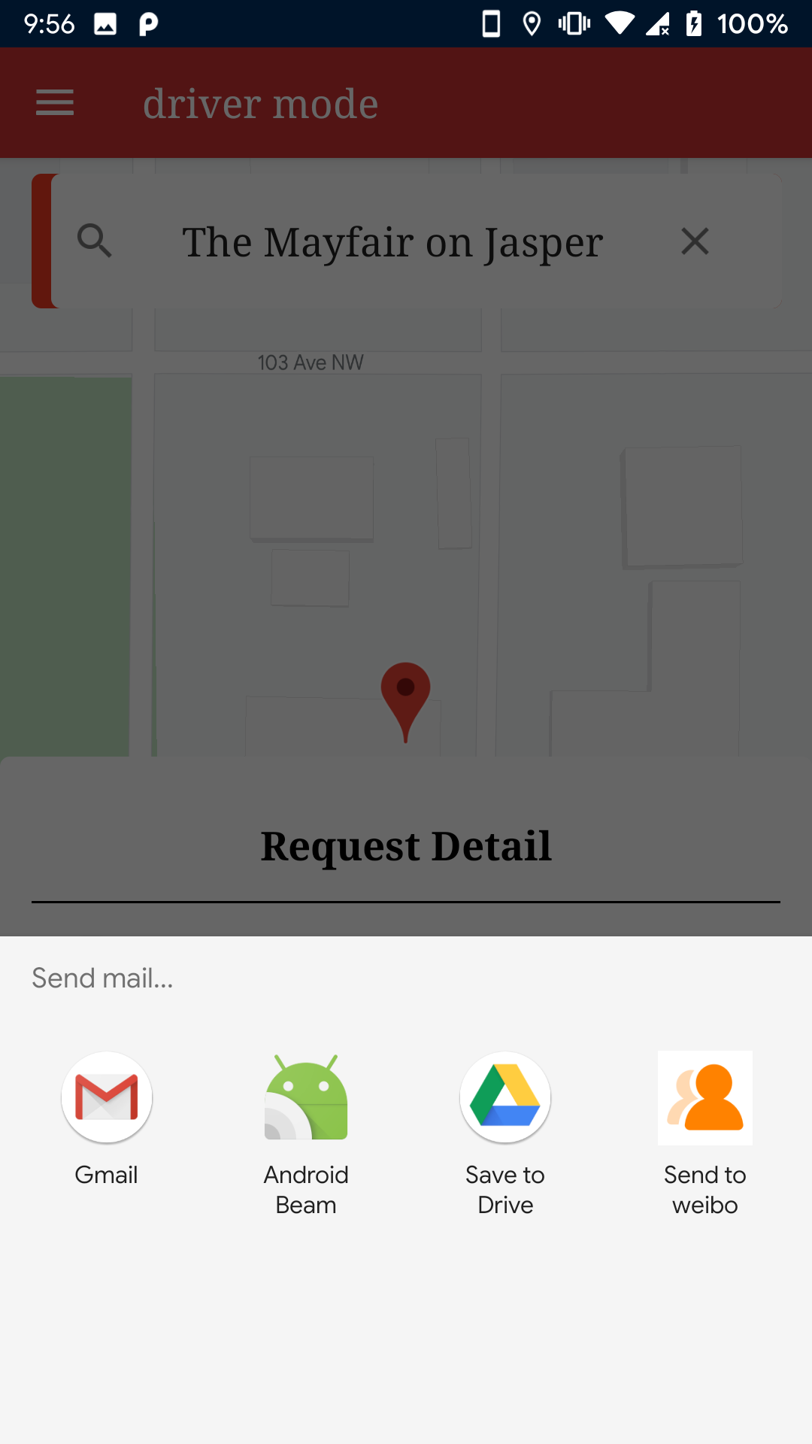
Search Available Request
Click
Detail

Slide 21
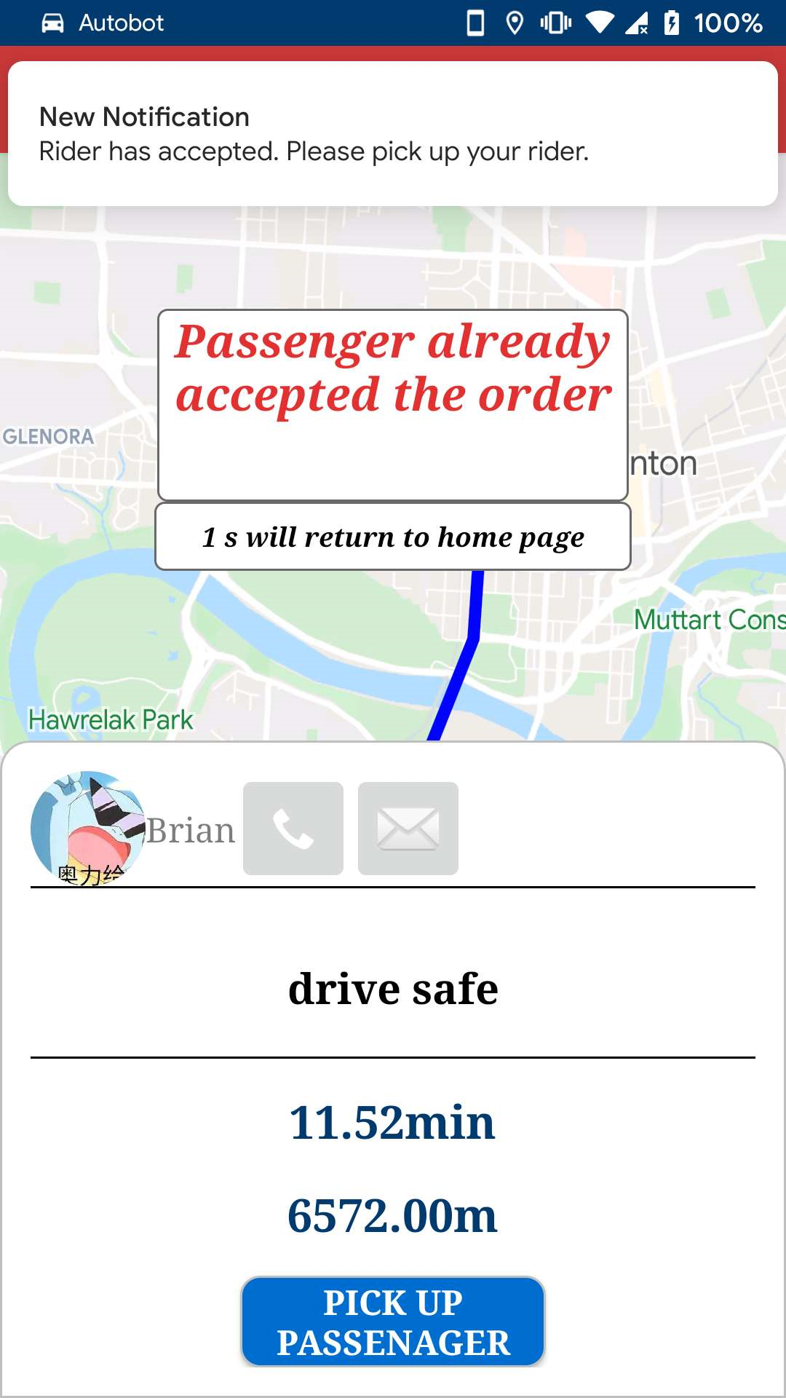
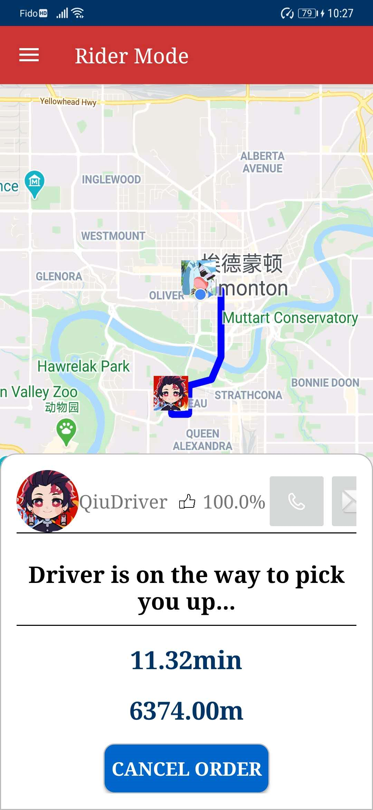
When Rider Accept Driver
Driver
Rider
Notifition

Slide 22
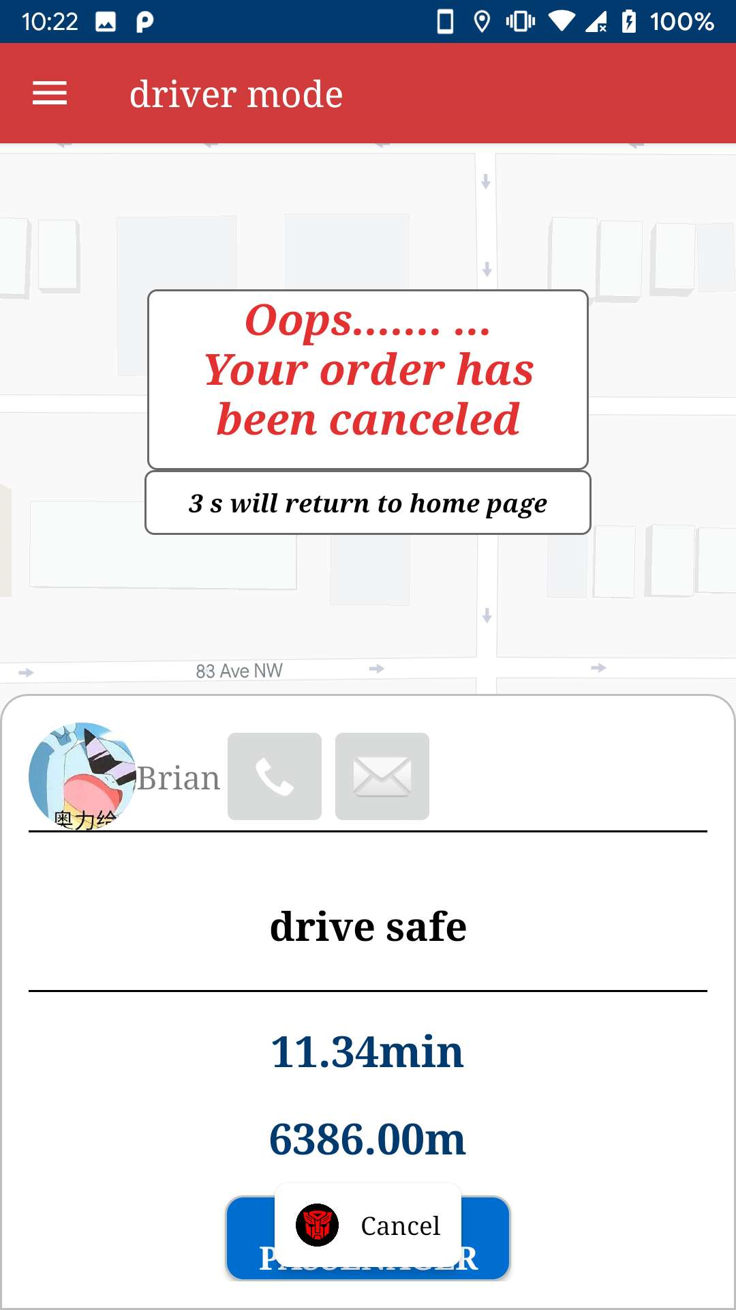
When Rider Cancel Request
Cancel

Slide 23
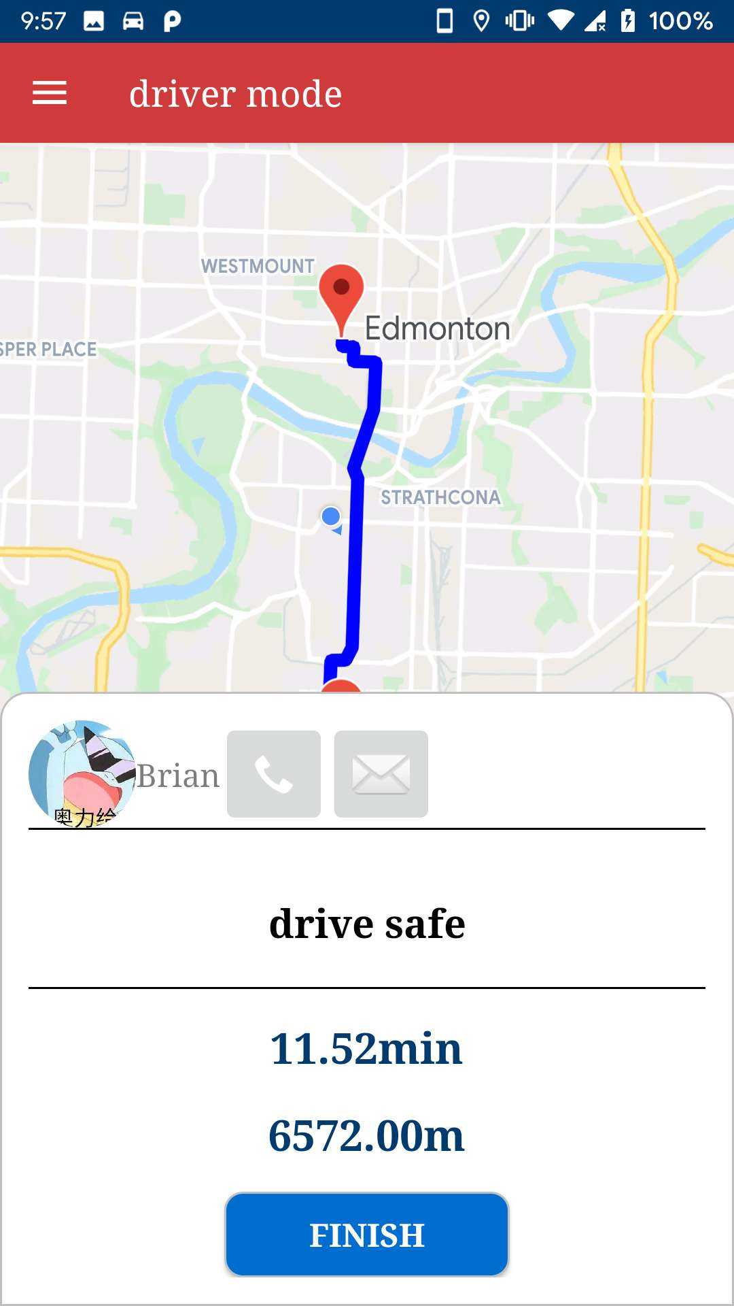
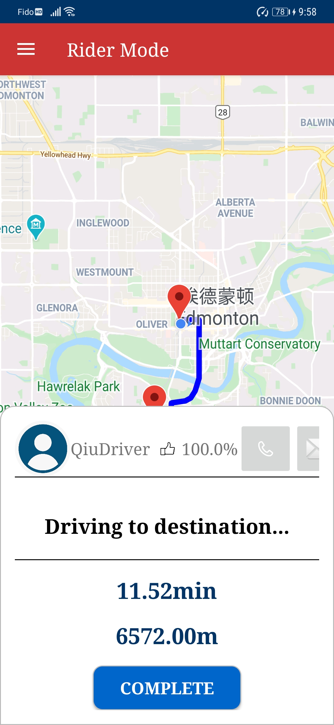
Driver pick up Rider
Driver
Rider

Slide 24
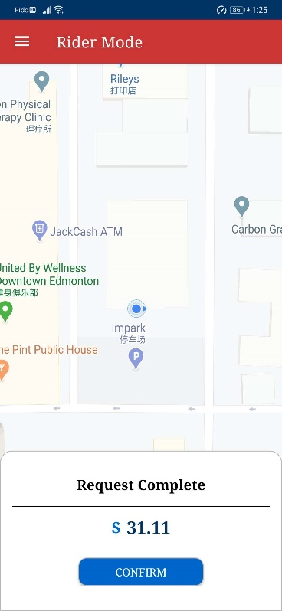
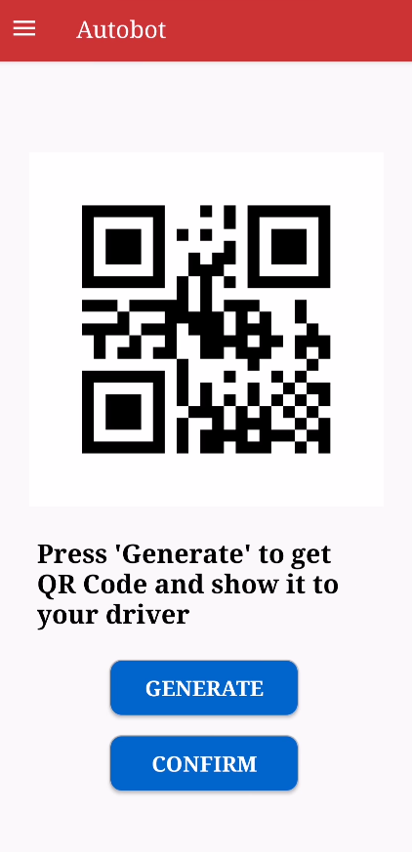
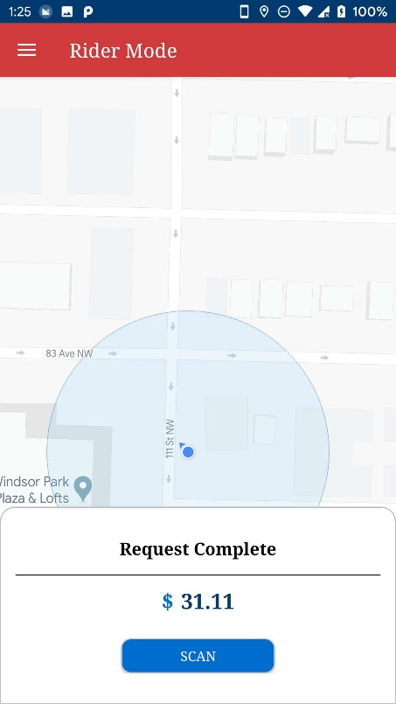
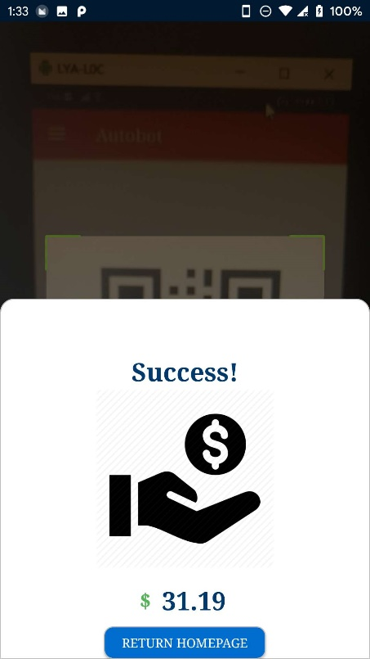
Trip Complete and Pay
Driver
Rider

Slide 25
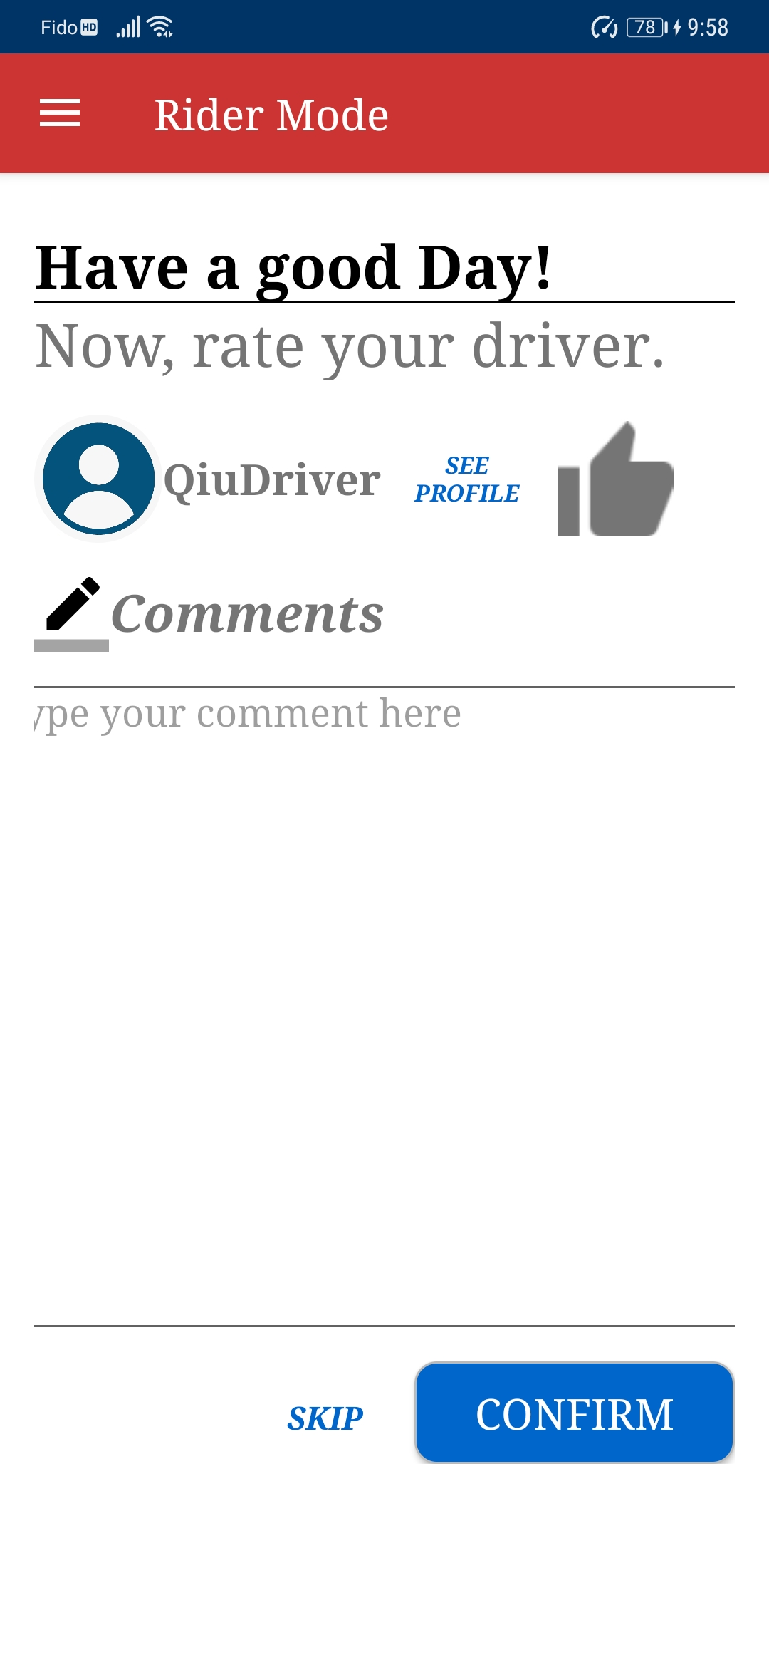
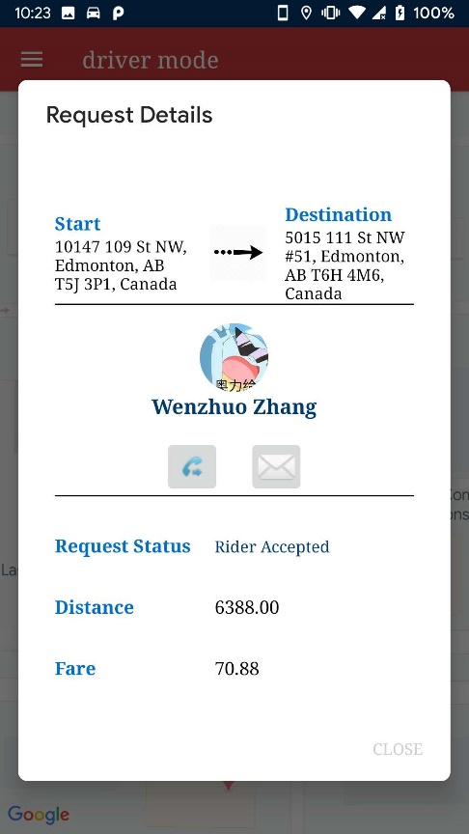
Rate Offline

Slide 26
Part Four
Interaction

Slide 27
Thank you for listening

